Slide 1

Climate Forecasting
Leveraging Benchmark, Exponential Smoothing, and ARIMA forecasting methods to predict daily temperatures
By: Austin Jia
March 20, 2022

Slide 2

Motivation
We know temperatures are climbing, but can we accurately forecast those trends into the future?

Slide 3

Exploratory Data Analysis
Data
Wrangling
Benchmark
Forecasts

Slide 4

Summary Statistics
1,576 observations
Delhi regional data
2013-2017 period
25.22º average temp
5 attributes

Slide 5
Data Dictionary
Variable | Definition | Type | Response vs. Predictor
meantemp | Recorded temperature in Celsius on the given date | Numeric | Response
date | mm-dd-yyyy format of the day a temperature is recorded | Date | Predictor
humidity | Recorded humidity on the given date | Numeric | Predictor
wind_speed | Recorded wind speed in km/h on the given date | Numeric | Predictor
meanpressure | Average barometric temperature recorded on given date | Numeric | Predictor

Slide 6
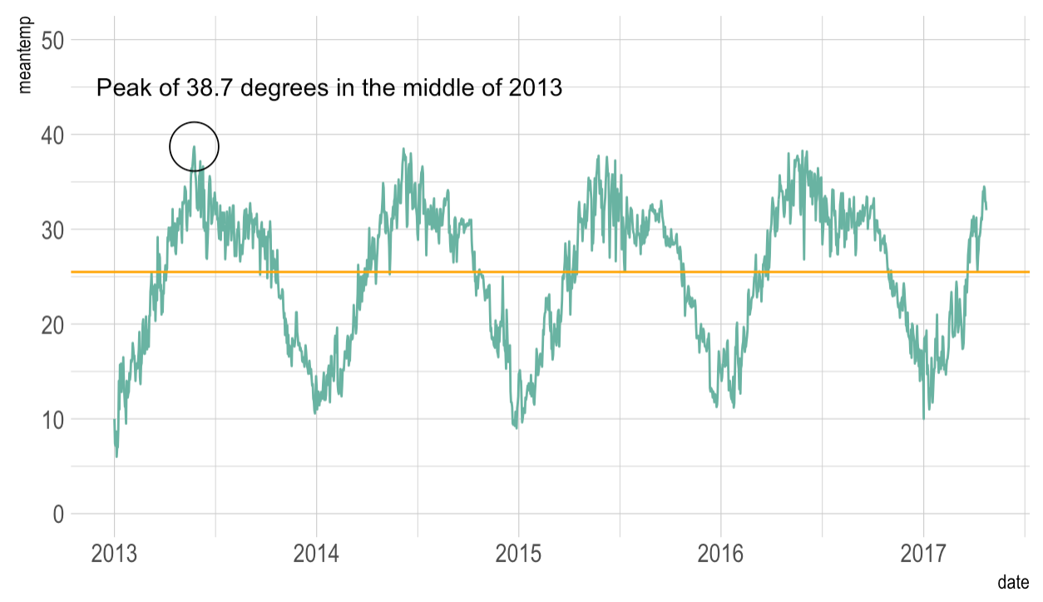

Visualizing Mean Temperature
Annual peaks and troughs mapping out to seasons. Peak temperature was recorded in 2013, with no visible upward or downward long-term trend visible.
Figure 1: Line plot of meantemp variable over date range

Slide 7
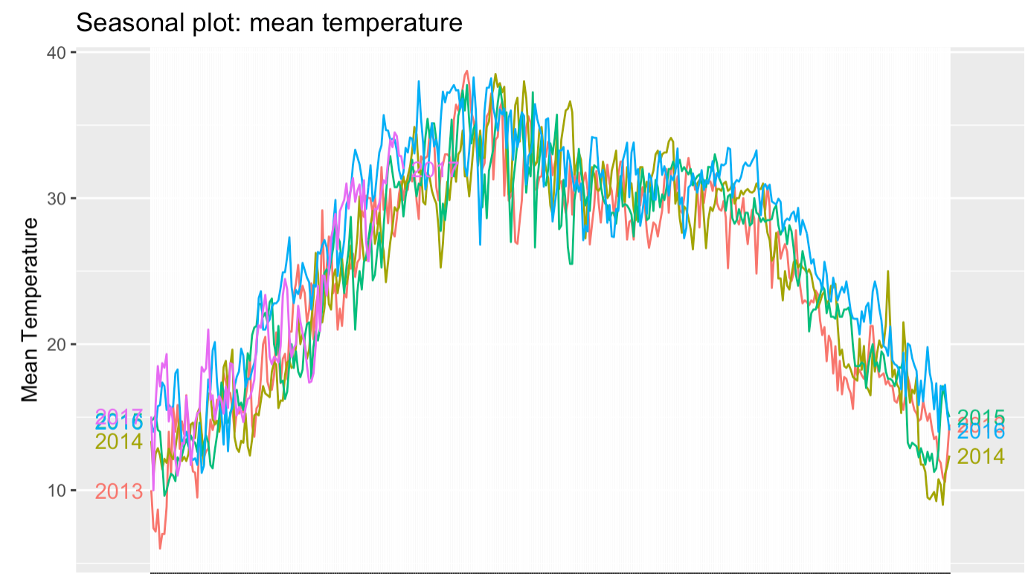
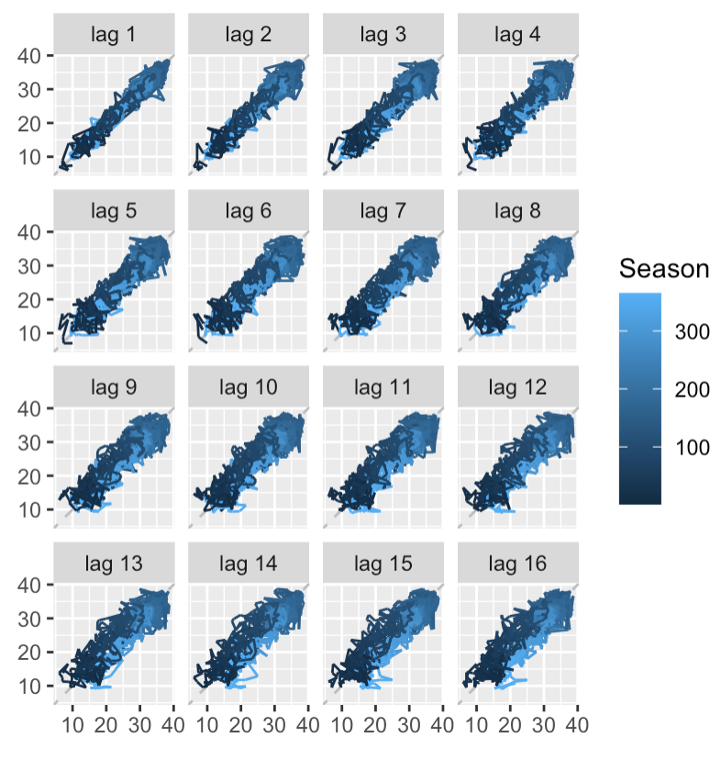
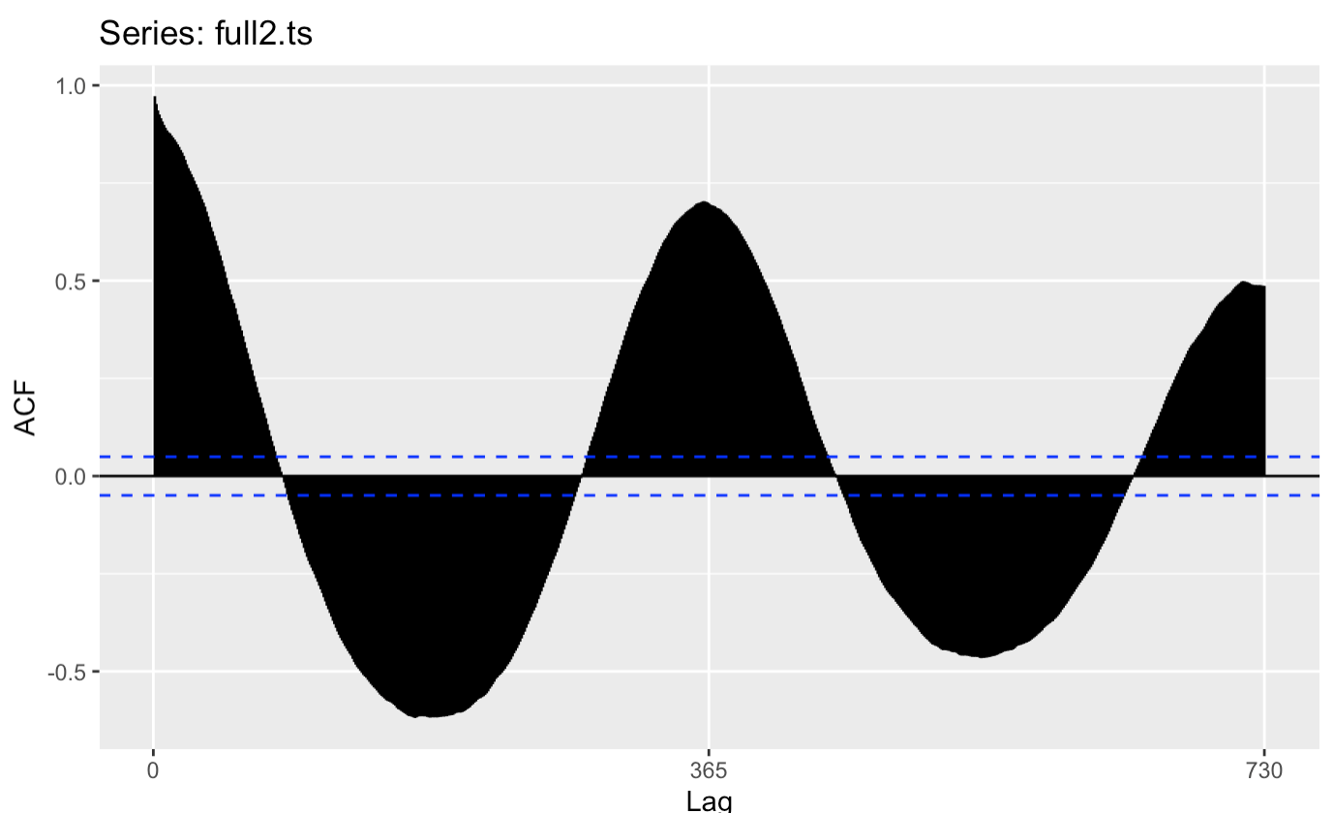
Visualizing Seasonality
Figure 2: Year-over-year of seasonality plots
Figure 3: Year-over-year lag plots
Figure 4: Year-over-year ACF plot
Overlay of the seasonal plots showcase that there is a minor upward trend in overall temperatures year-over-year.
Linearity of the lag plots and oscillating nature of autocorrelation plot further emphasizes seasonality of mean temperatures

Slide 8
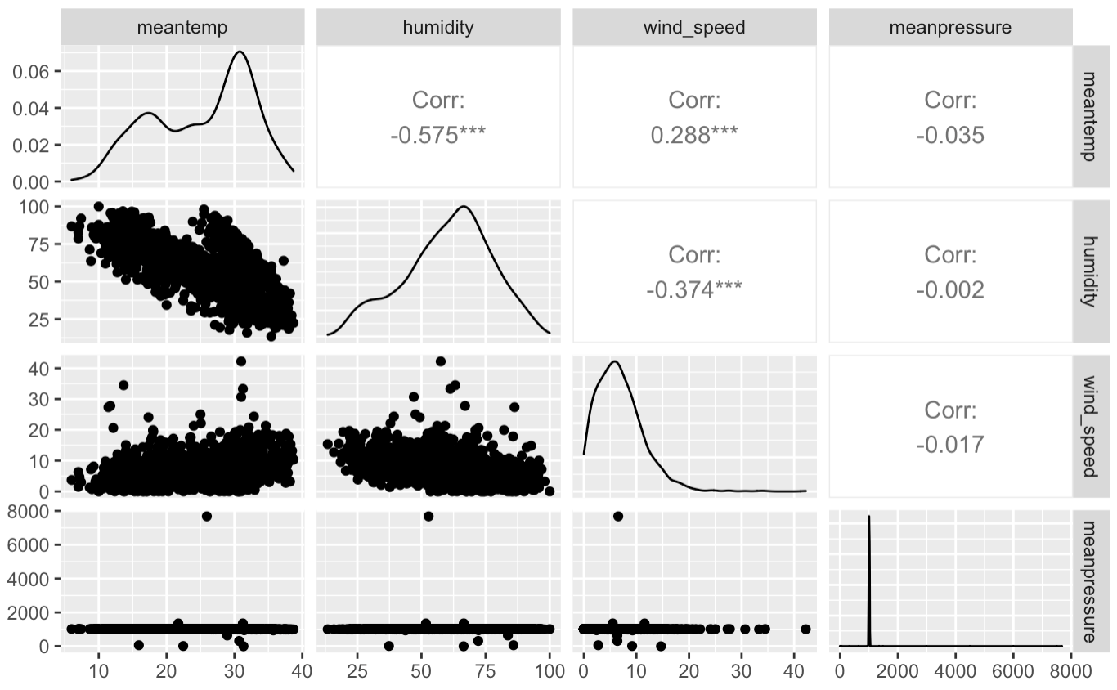
EDA of Quantitative Variables
Humidity and mean temperature appears to have a moderately strong relationship, motivating the OLS forecasting exercise later
Figure 5: Correlation Matrix of Quantitative Variables

Slide 9
Exploratory Data Analysis
Data
Wrangling
Benchmark Forecasts
Exponential Smoothing

Slide 10
Dataset Wrangling
A
Conversion of dataframe object into time-series object pioneered by Hyndman and Athanasopoulos to pipe into R forecasting tools
B
Conversion of date variable from character type into Date type
C
No missing data to impute
D
We split the imputed dataset into an 80-20 train-test split to allow for model selection, resulting in 1,462 train values and 114 test values.

Slide 11
Data Wrangling
Benchmark
Forecasts
Exponential
Smoothing
Exploratory
Data Analysis
ARIMA
Forecasting

Slide 12
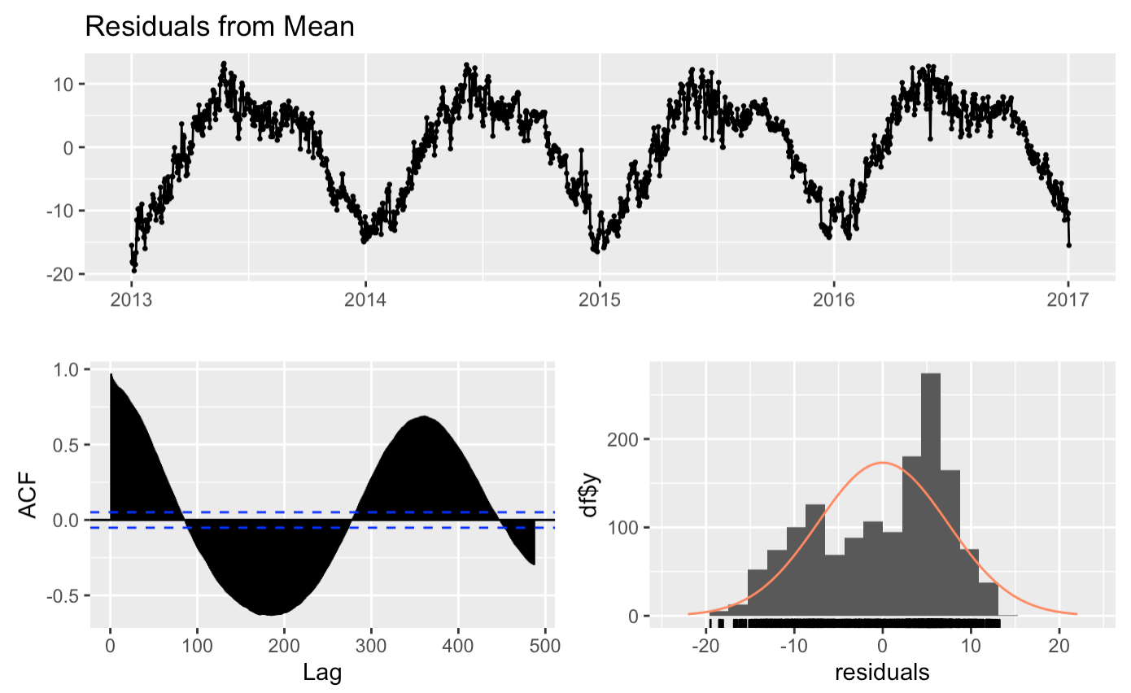
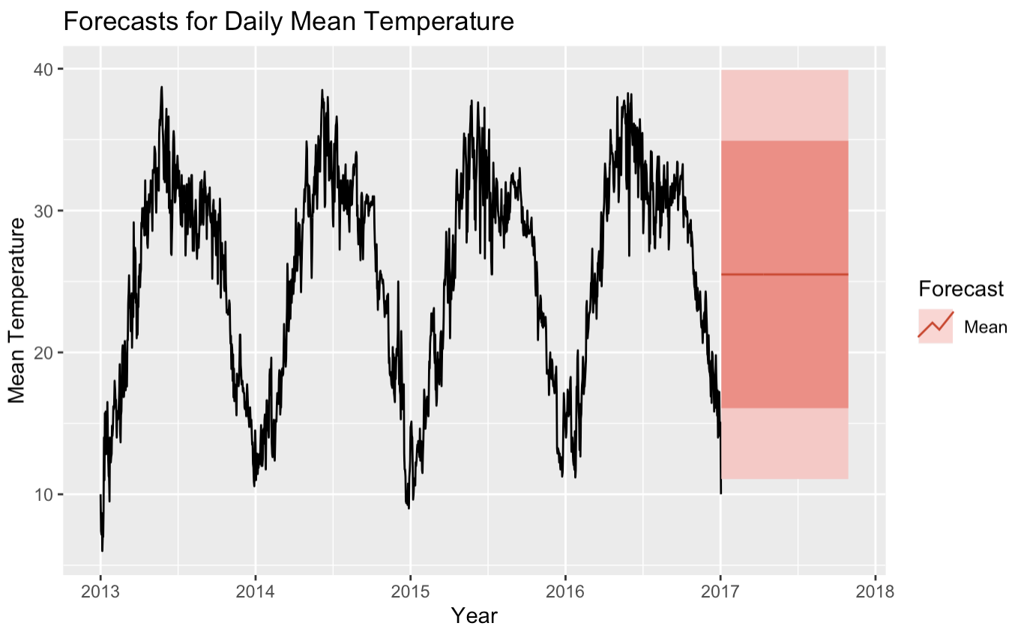
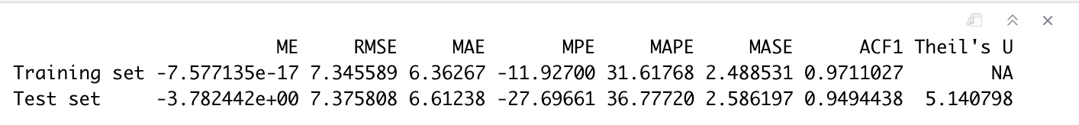
Mean Forecast Forecast equals average of all historical observations
Figure 7: Check Residuals; residuals are not normally distributed; ACF plot looks too correlated
Figure 6: Mean Forecasting
Figure 8: RMSE of 7.37 on test set

Slide 13
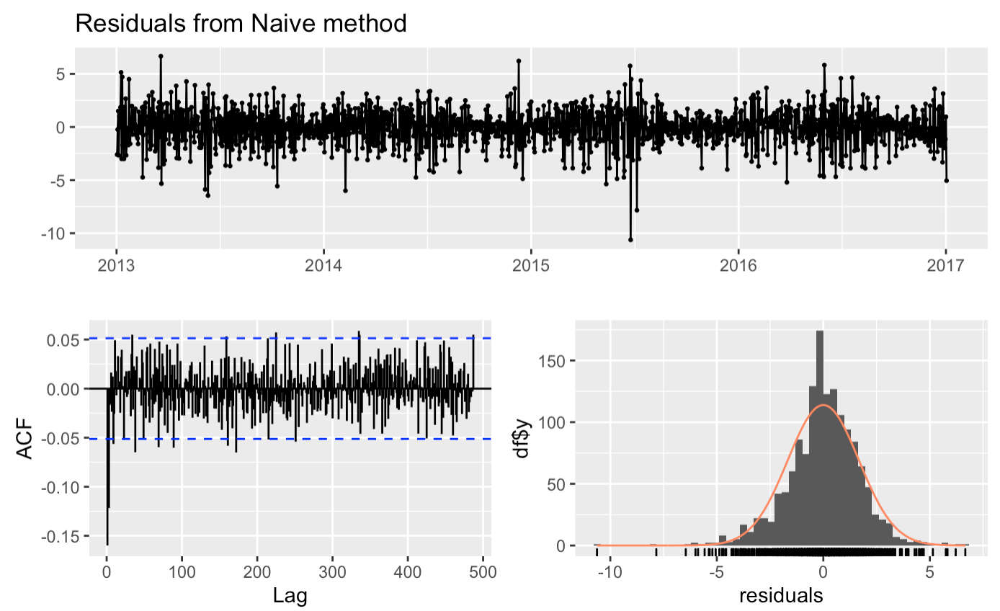
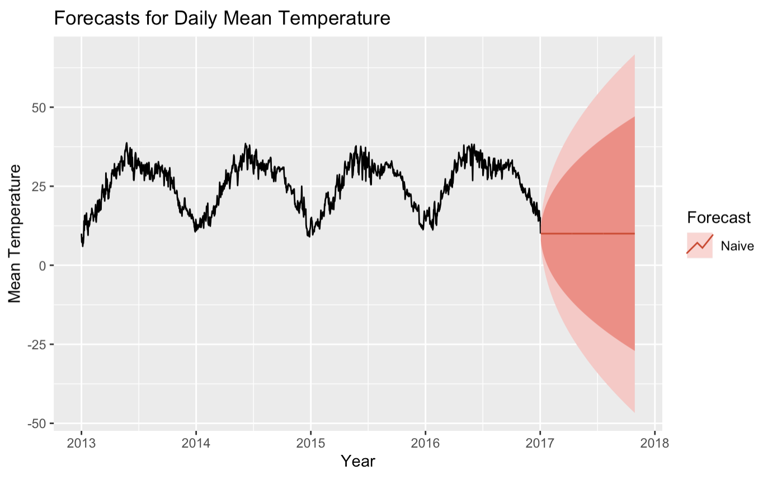
Naive Forecast Forecast equals last recorded observation
Figure 10: Check Residuals; residuals are much more normally distributed and within acceptable threshold of acceptable correlation
Figure 9: Naïve Forecasting
Figure 11: RMSE of 13.32 on test set

Slide 14
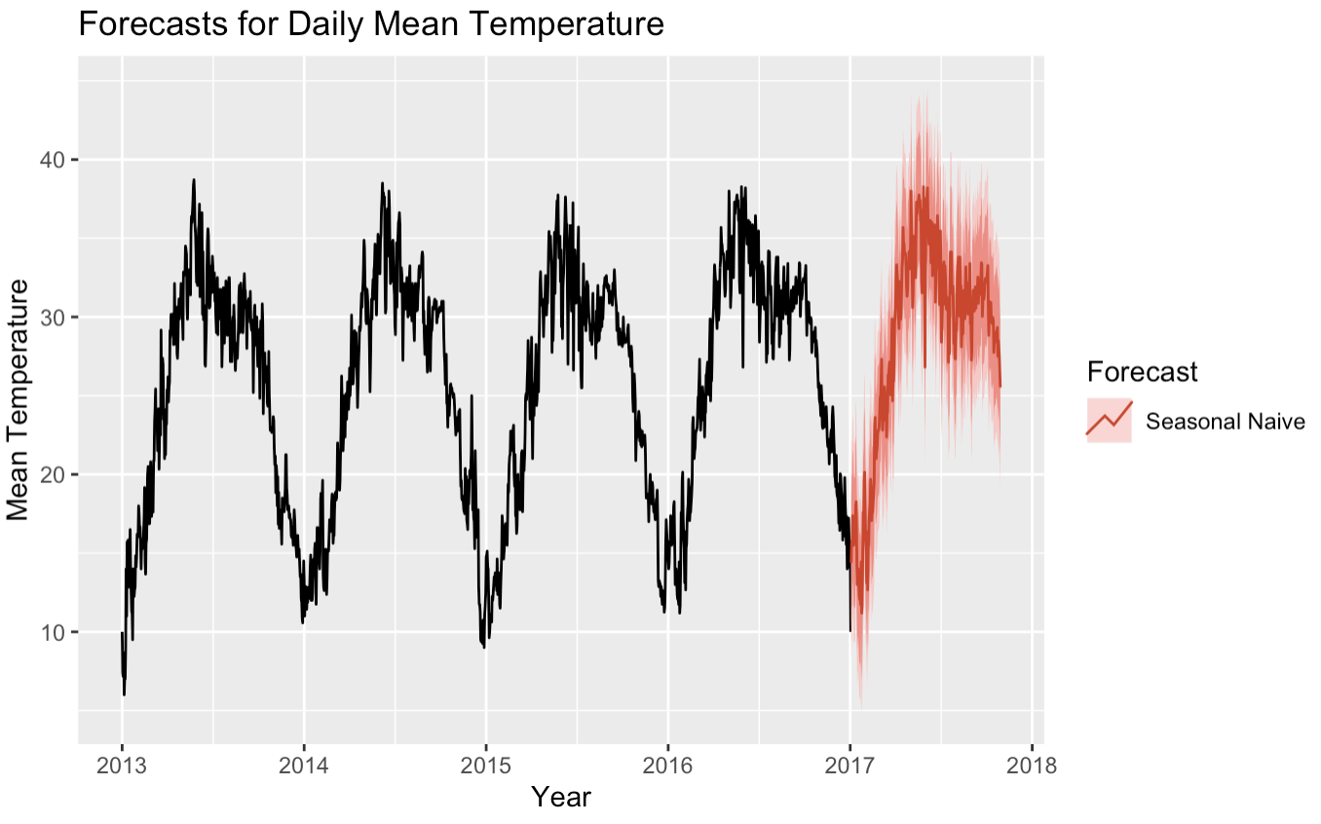
Seasonal Naive Forecast Forecast equals last recorded observation in the same season
Figure 13: Check Residuals; residuals look normal, uncorrelated
Figure 12: Seasonal Naïve Forecasting
Figure 14: RMSE of 3.09 on test set

Slide 15
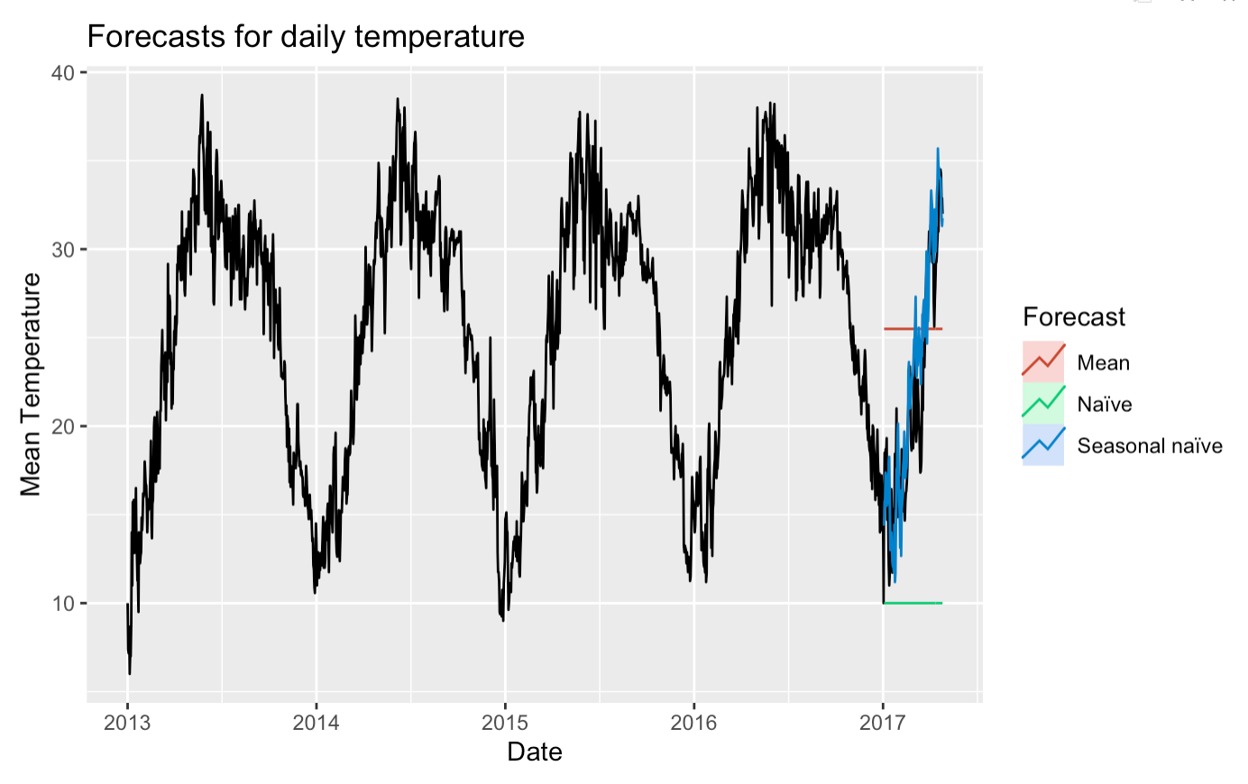
Overlay of Benchmark Forecasts
Seasonal Naïve forecast appears to be the closest fit within the benchmark forecasts.
Figure 15: Overlay of Forecast Methods

Slide 16
Benchmark Forecasts
Exponential
Smoothing
ARIMA
Forecasting
Data
Wrangling
Conclusions

Slide 17
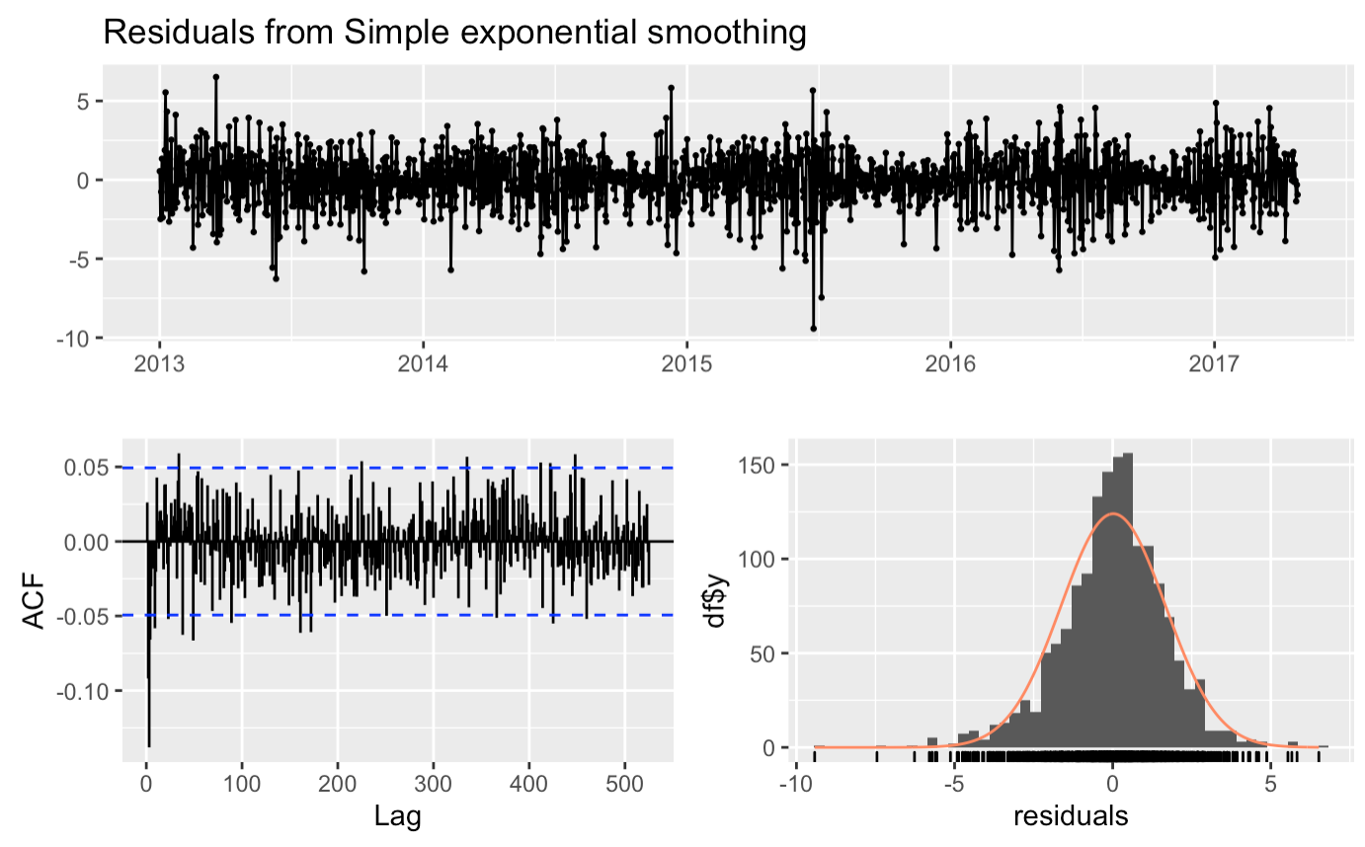
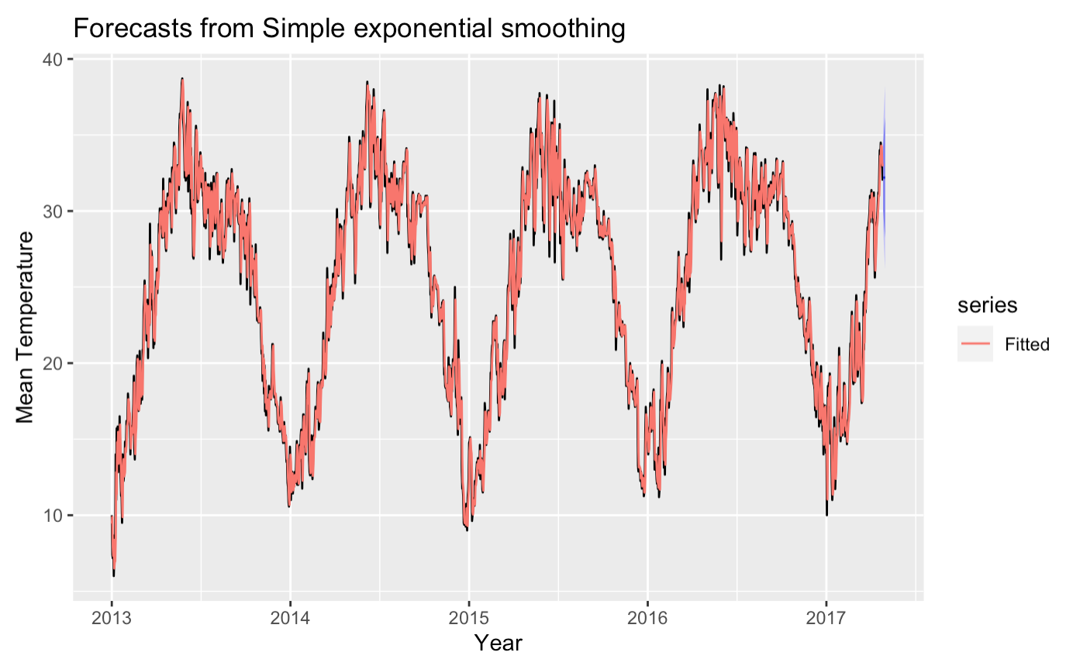
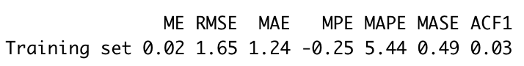
Simple Exponential Smoothing Simple down-weighting of observations from long ago
Figure 17: Check Residuals; residuals are normally distributed and sufficiently uncorrelated
Figure 16: Mean Forecasting
Figure 18: RMSE of 1.65 on test set

Slide 18
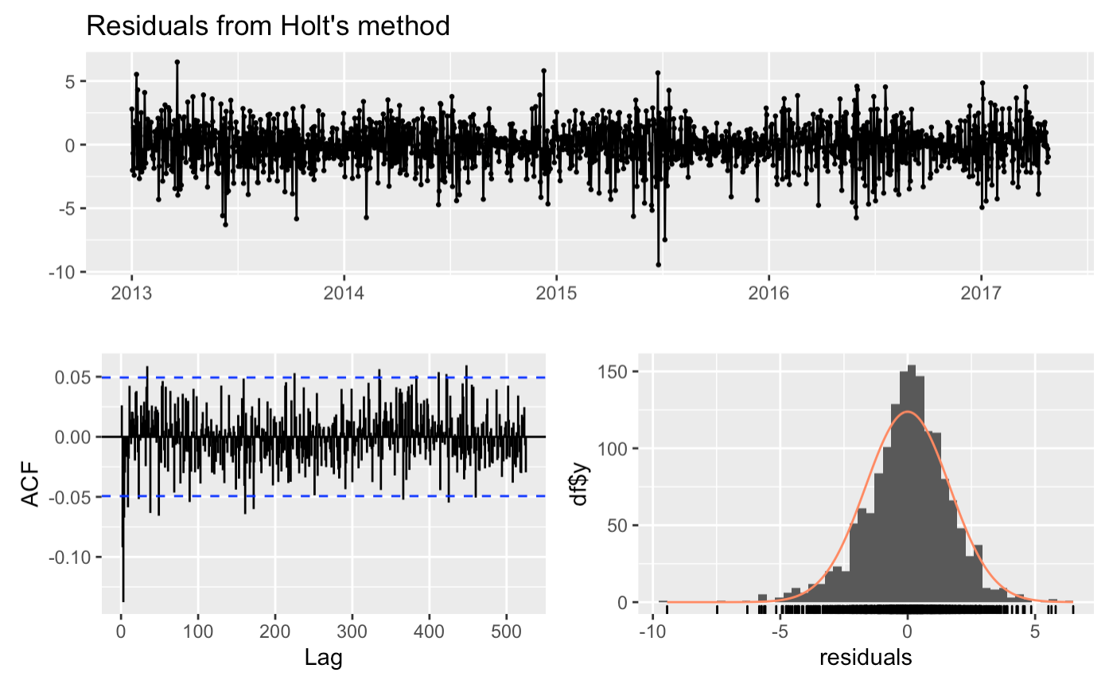
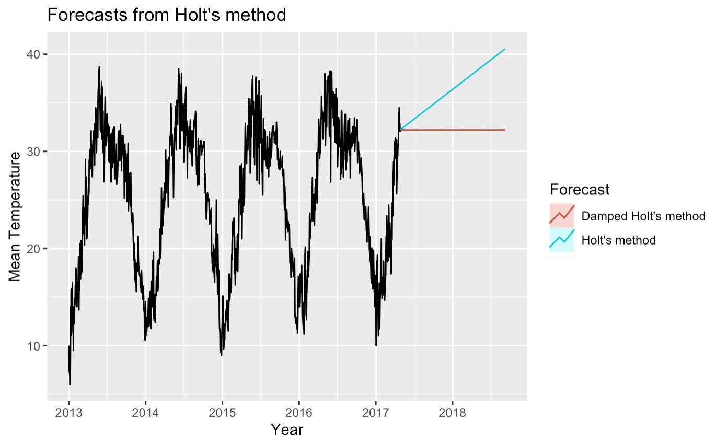
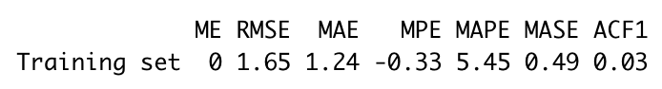
Holt and Dampened Holt Smoothing Simple down-weighting of observations from long ago
Figure 20: Check Residuals; residuals are normally distributed and sufficiently uncorrelated
Figure 19: Mean Forecasting
Figure 21: RMSE of 1.65 on test set

Slide 19
Exponential Smoothing
ARIMA
Forecasting
Conclusions
Benchmark
Forecasts
Limitations and Next Steps

Slide 20
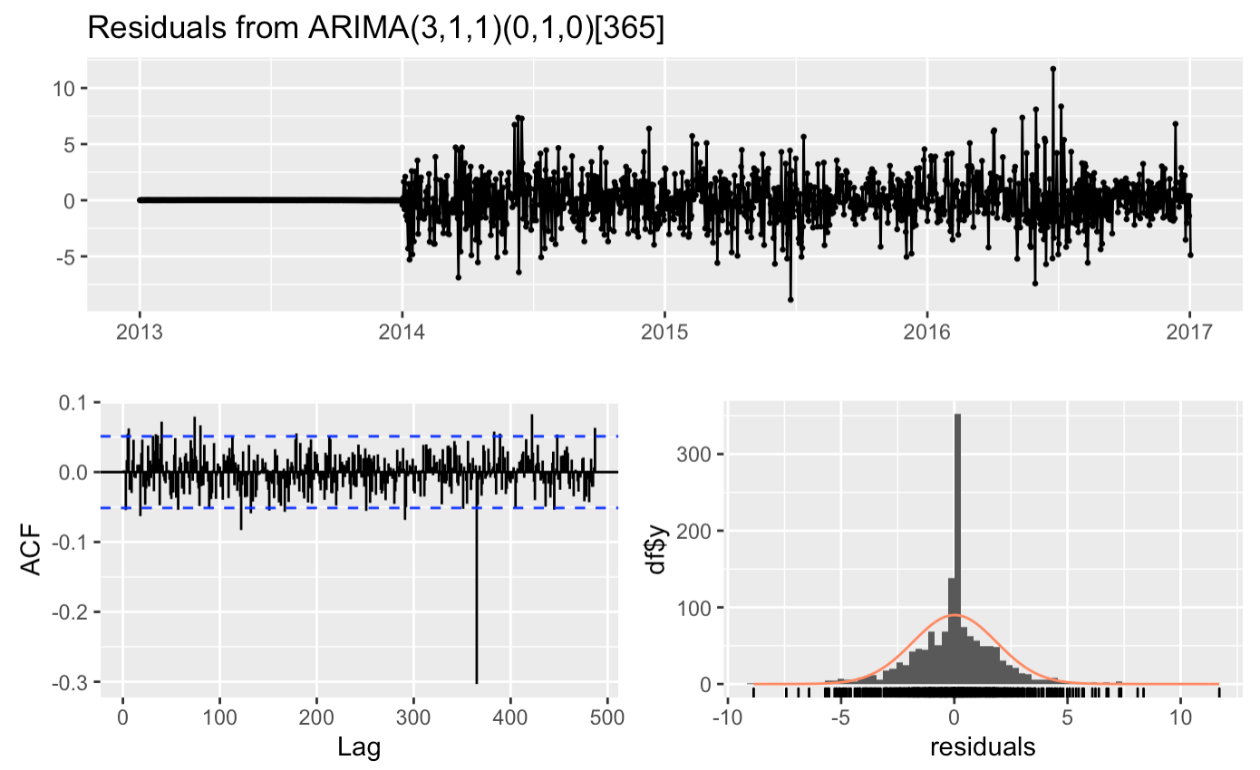
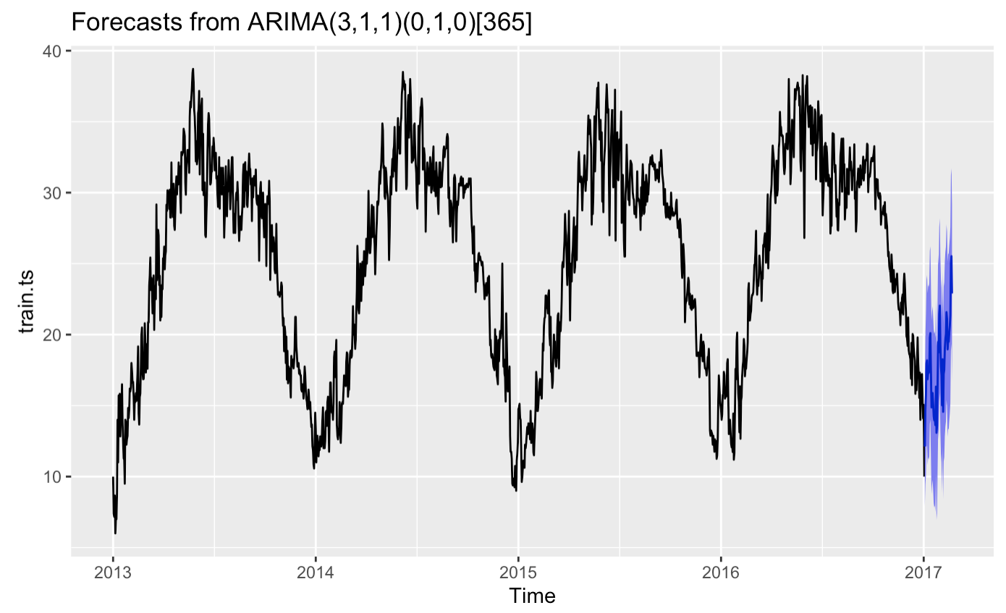
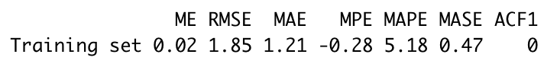
ARIMA Forecasting Leveraging auto-regression
Figure 23: Check Residuals; residuals are normally distributed and sufficiently uncorrelated
Figure 22: Mean Forecasting
Figure 24: RMSE of 1.65 on test set

Slide 21
ARIMA Forecasting
Conclusions
Limitations and Next Steps
Exponential
Smoothing
Appendix

Slide 22
Conclusions
Model Selection
In context with the benchmark forecasts (mean, naïve, and seasonal naïve), exponential smoothing and ARIMA methods perform much better
We select the Simple Exponential Smoothing forecasting method, at the lowest 1.65 RMSE
SES forecasting model predicts a 2017 collection of mean temperatures that mirrors the seasonality of the previous year

Slide 23
ARIMA Forecasting
Conclusions
Limitations and Next Steps
Exponential
Smoothing
Appendix

Slide 24
Limitations and Next Steps
Limitations
Next Steps
Holt-Winters exponential smoothing method could not be deployed due to the daily frequency of the time-series data, which could have improved fit
Relatively low number of observations
Lack of compelling trend pattern
Deployment of more robust forecasting methods that were not deeply explored within the scope of this project, including linear regression and decomposition methods

Slide 25

Limitations and Next Steps
Appendix
Conclusions

Slide 26
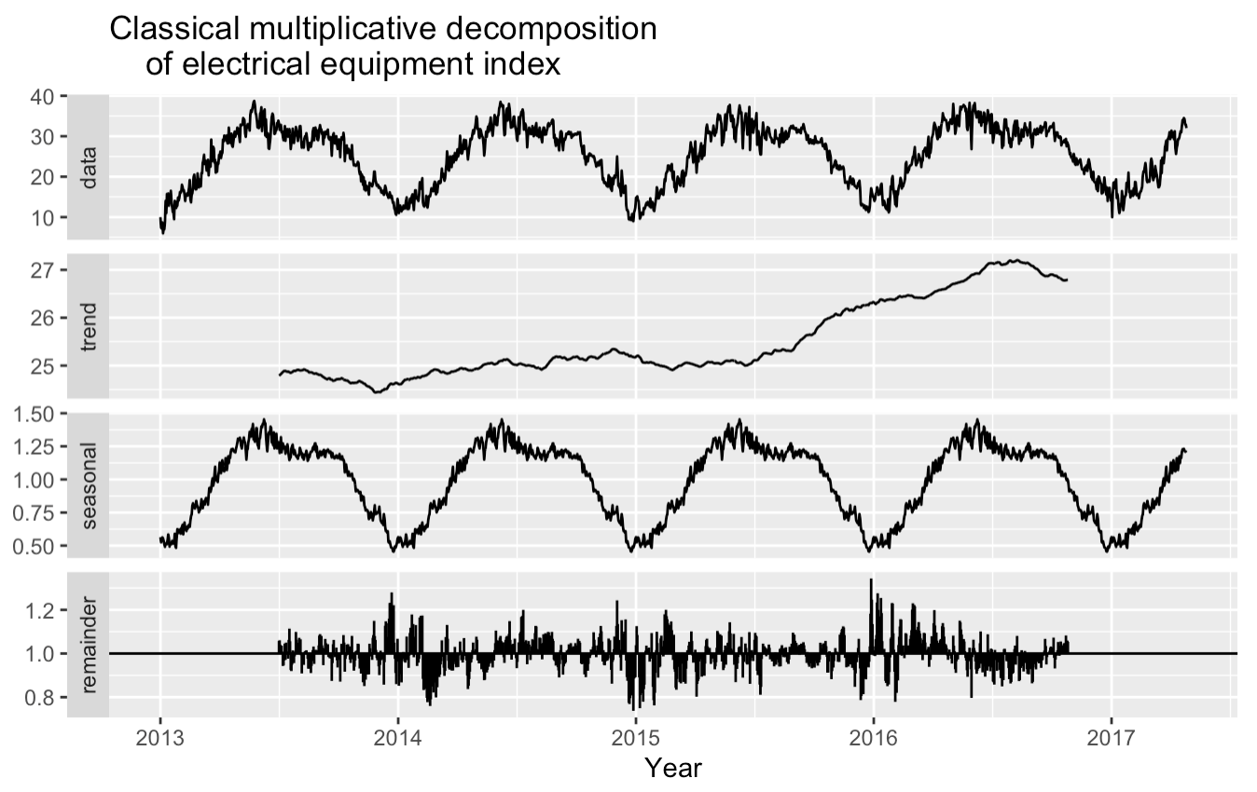
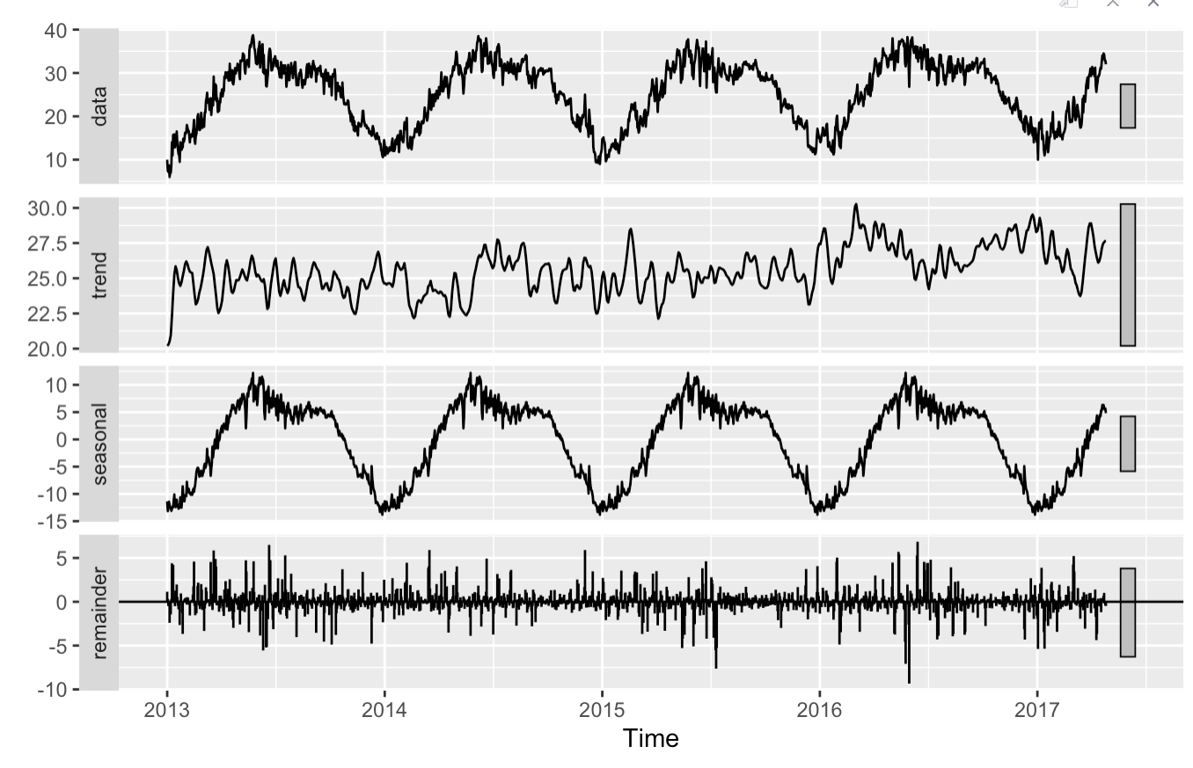
Decomposition
Figure 25: Classical Decomposition
Figure 26: STL Decomposition

Slide 27
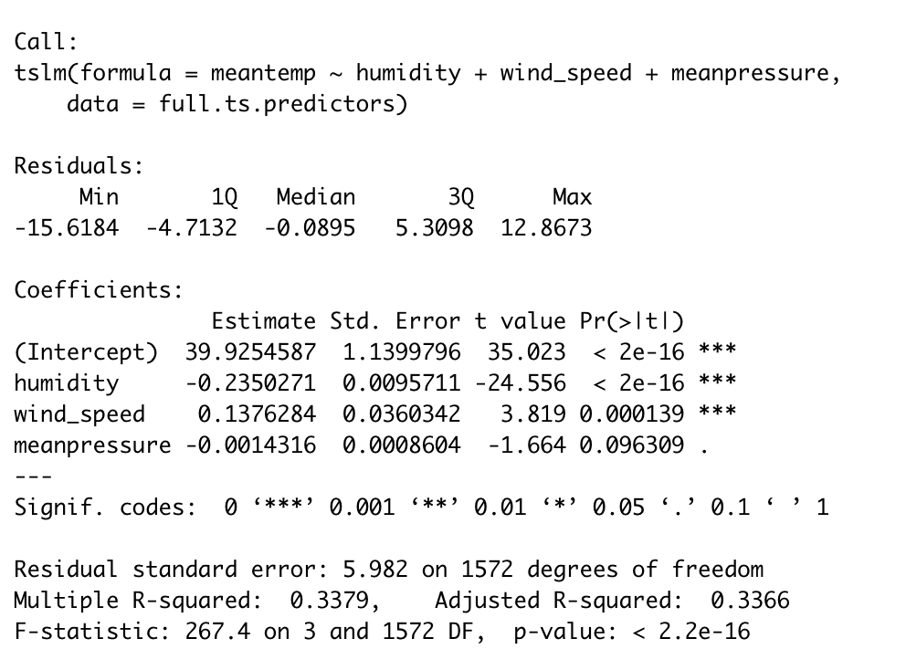
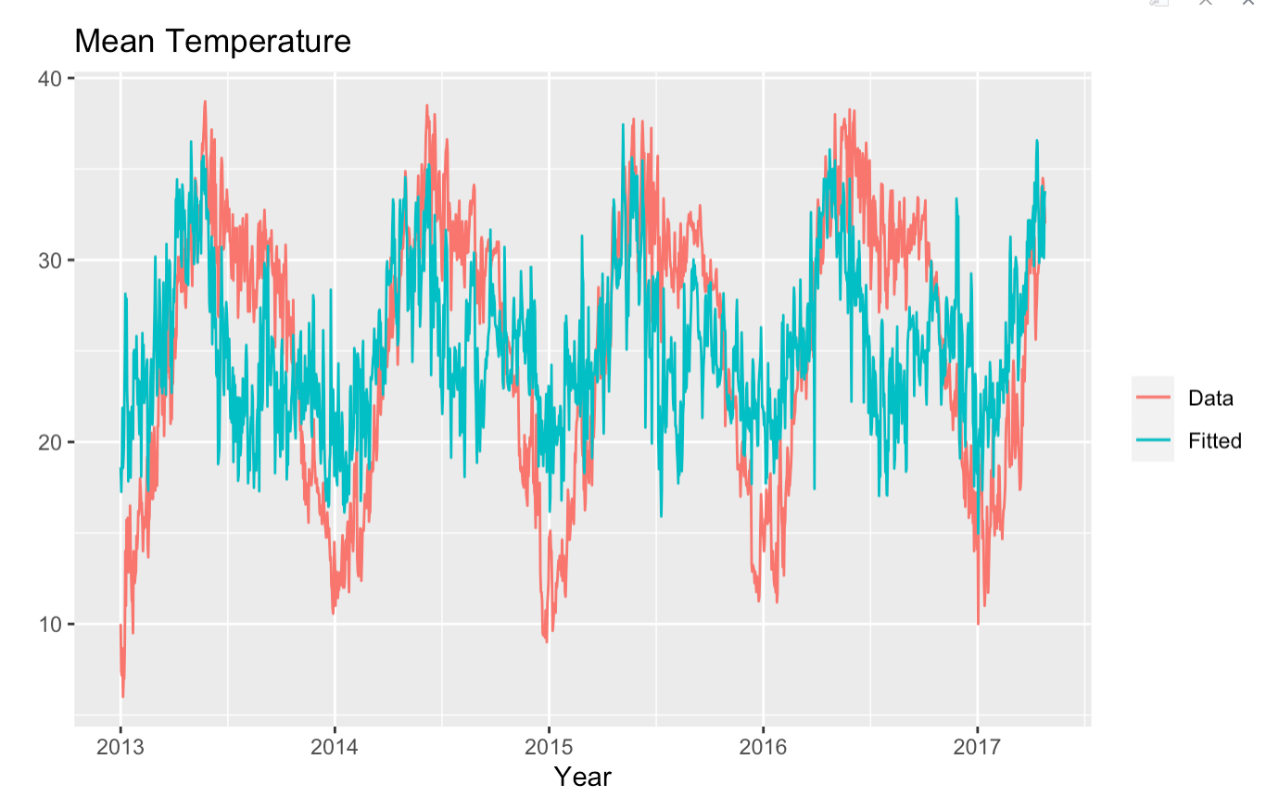
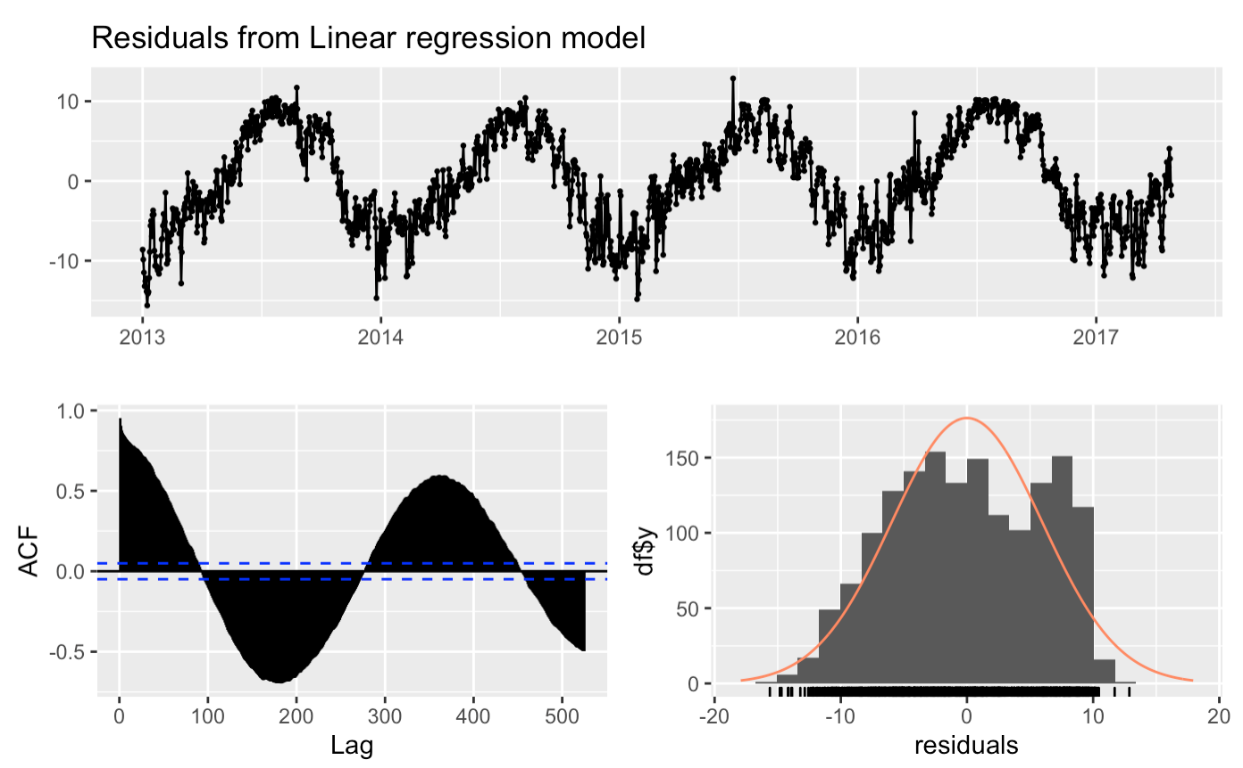
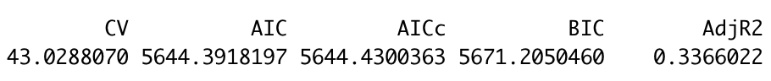
Linear Regression Forecasting
Figure 29: Fitted vs. Actuals
Figure 27: Regression Output
Figure 28: R-Squared of .3366x
Figure 30: Check Residuals

